Slide 1
CFD in Cyber-Learning Platform at NCHC
Heng-Chuan KAN, Ph.D.

Slide 2
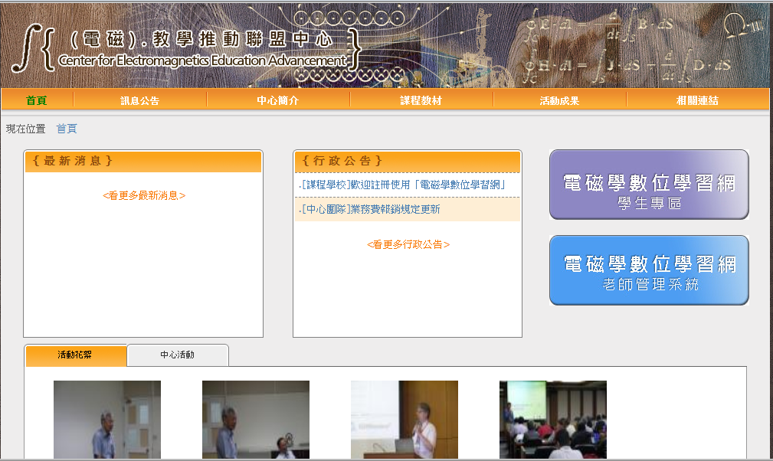
Cyber-Learning Platform at NCHC (http://www.emedu.org.tw)

Slide 3
Characteristics of Cyber-Learning Platform at NCHC
Management System for Lectures and Students
Modularization of Teaching Contents
Multi-Media and Interactive Simulations as Supplemental Teaching Contents
Learning Path Management System
Evaluation System

Slide 4

Goal
Enhance Learning Efficiency of Students in Thermal-Fluid Engineering Field through Multi-Media and Simulation Based Teaching Contents

Slide 5
First-Phase Approaches
Collection of Thermal-Fluid related Course Information from Universities in Taiwan
Discussions/Meetings with Professors in Thermal-Fluid Engineering Education Platform to Define Current Educational Challenges, Needs & Wants
Development of Supplemental Teaching and Software Contents

Slide 6
Multi-Media and Interactive Simulations as Teaching Contents
Simulation Animation with JavaScript Presentation
Experimental Observation vs. Simulation Animation
Interactive Simulations by Open Source Software
Software Tools Development with JavaApplet/ JavaScript Presentation (Calculator)

Slide 7
Simulation Animation with JavaScript Presentation
Timelines, Pathlines, Streaklines, and Streamlines
http://paintingwordnotebook.nchc.org.tw/FM_OK/En-FM00002_Timeline_Pathline_Streakline_Streamline.html
No-Slip Boundary Condition
http://paintingwordnotebook.nchc.org.tw/FM_OK/En-FM00003_No_slip_BC.html

Slide 8
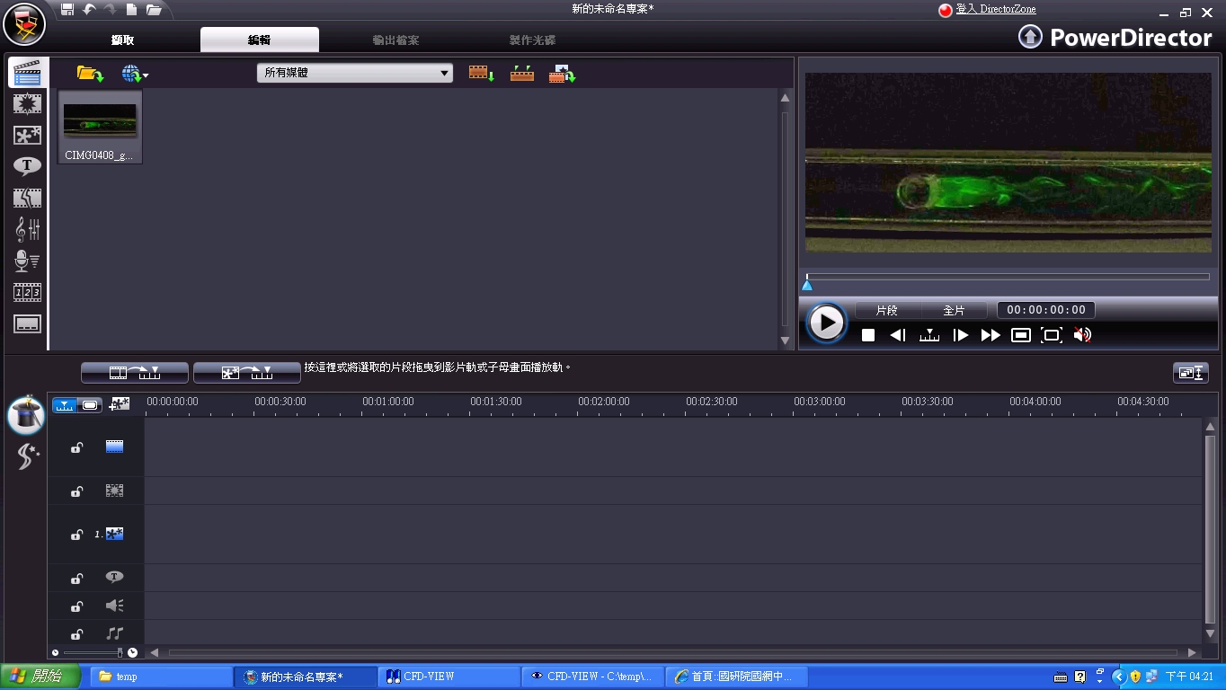
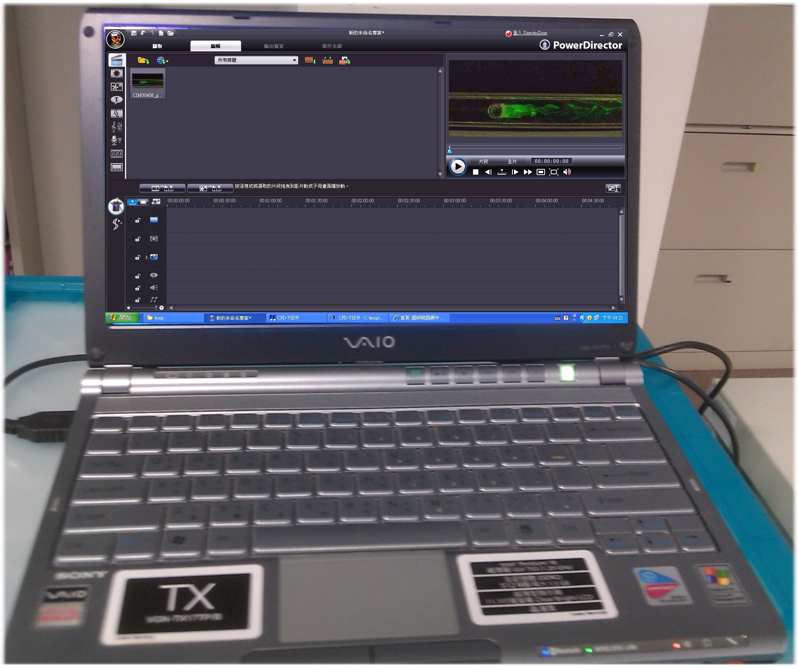
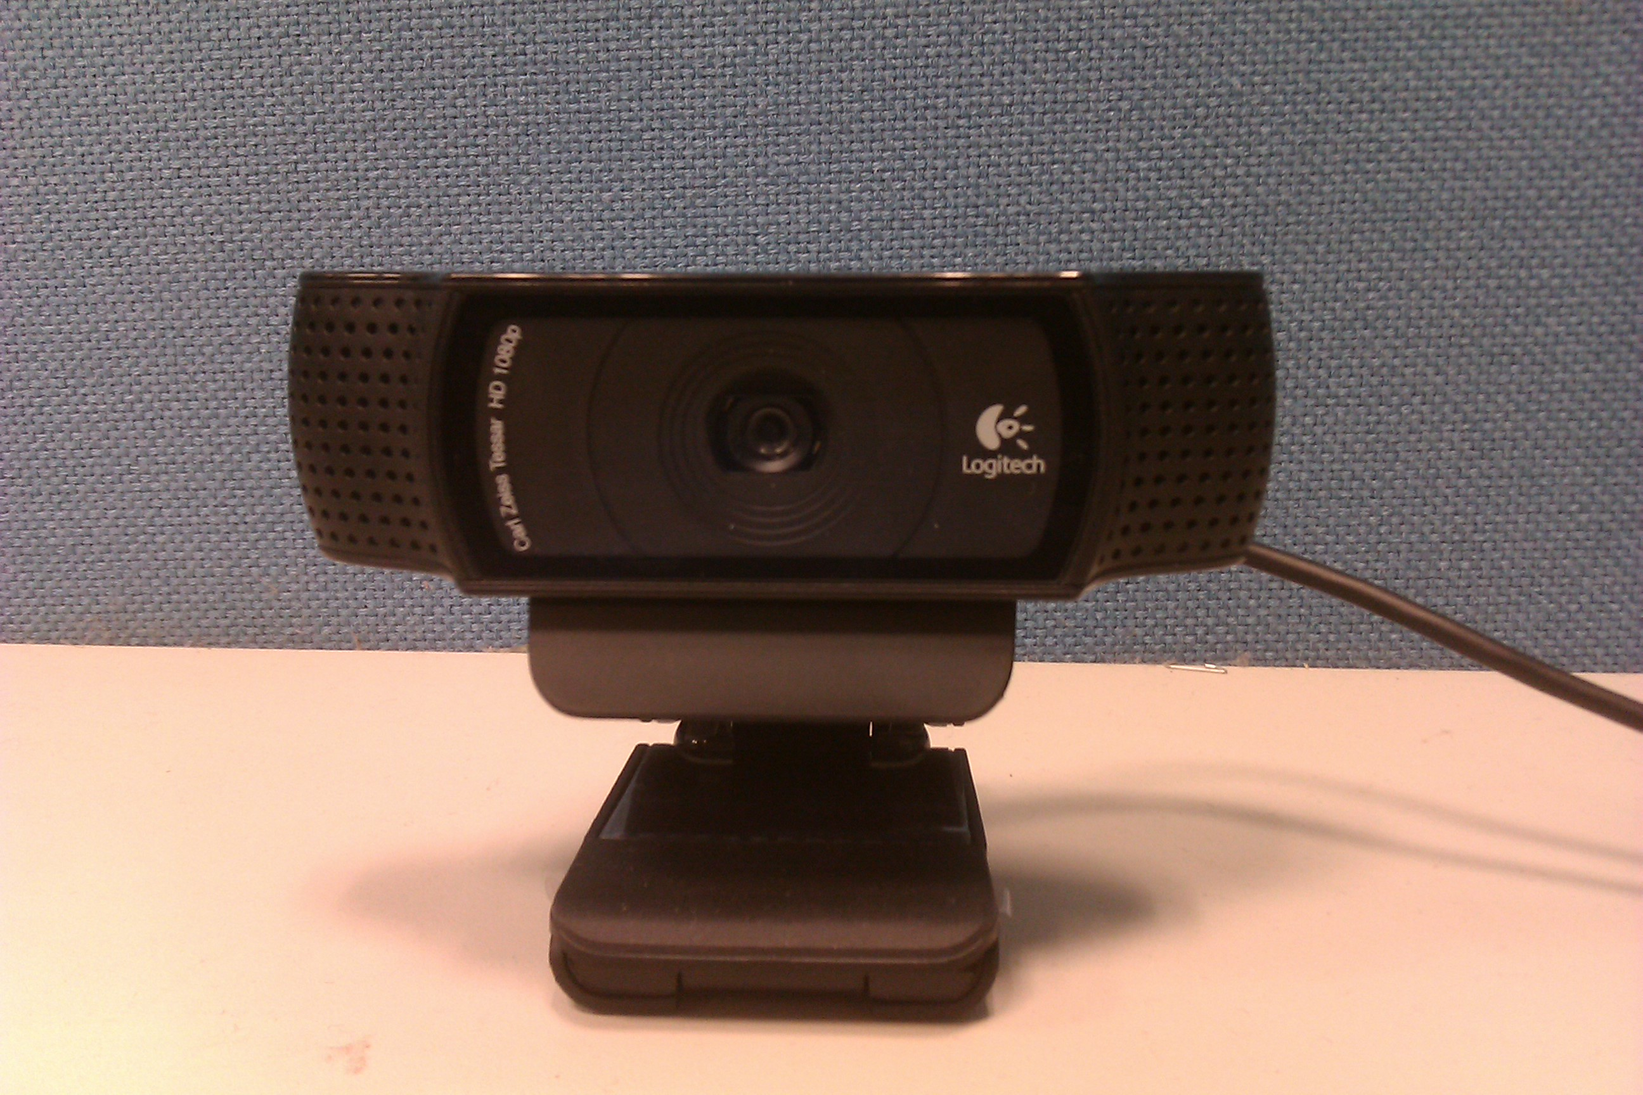
Experimental Observation vs. Simulation Animation
Flow Over a Cylinder
http://paintingwordnotebook.nchc.org.tw/FM_OK/En-FM00001_Flow_Past_a_Cylinder.html

Slide 9
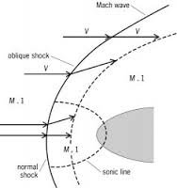
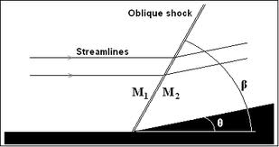
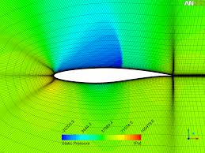
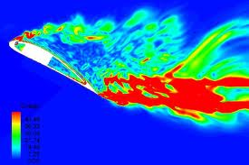
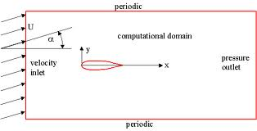
Simulation Based Teaching Contents (1/4)
Compressible Flows/Inviscid Flows
Oblique shock wave
Flow over an airfoil (NACA0012)

Slide 10
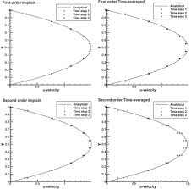
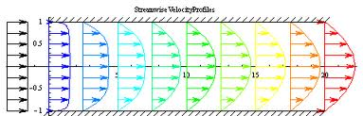
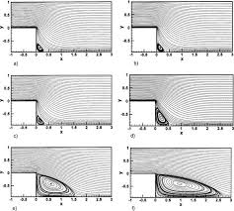
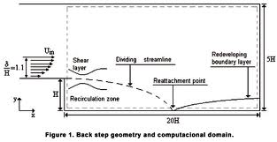
Simulation Based Teaching Contents (2/4)
Incompressible Flows/Viscous Flows
Open channel flow
Back facing step flow

Slide 11
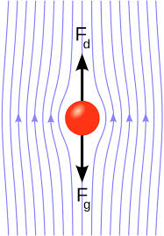
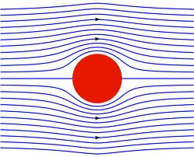
Simulation Based Teaching Contents (3/4)
Incompressible Flows/Viscous Flows
Ball dropping
Potential Flows
Flow over a cylinder

Slide 12
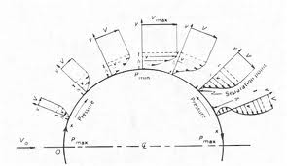
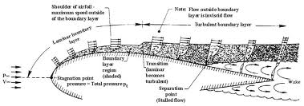
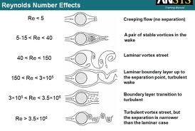
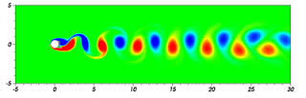
Simulation Based Teaching Contents (4/4)
Boundary Layer
Flow Separation
Vortex Shedding

Slide 13
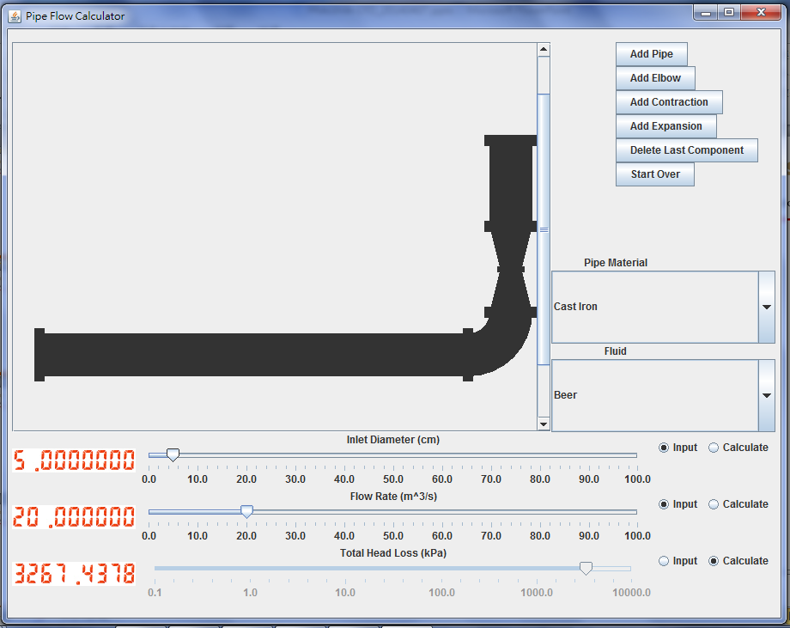
Pipe Flow Calculator

Slide 14
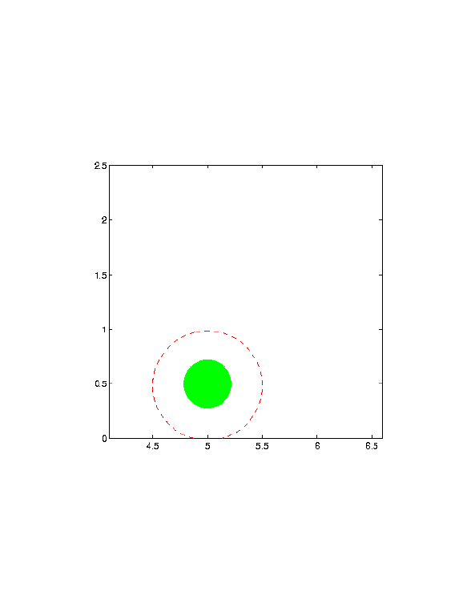
Interfacial Phenomena: Moving Boundary Problems

Slide 15
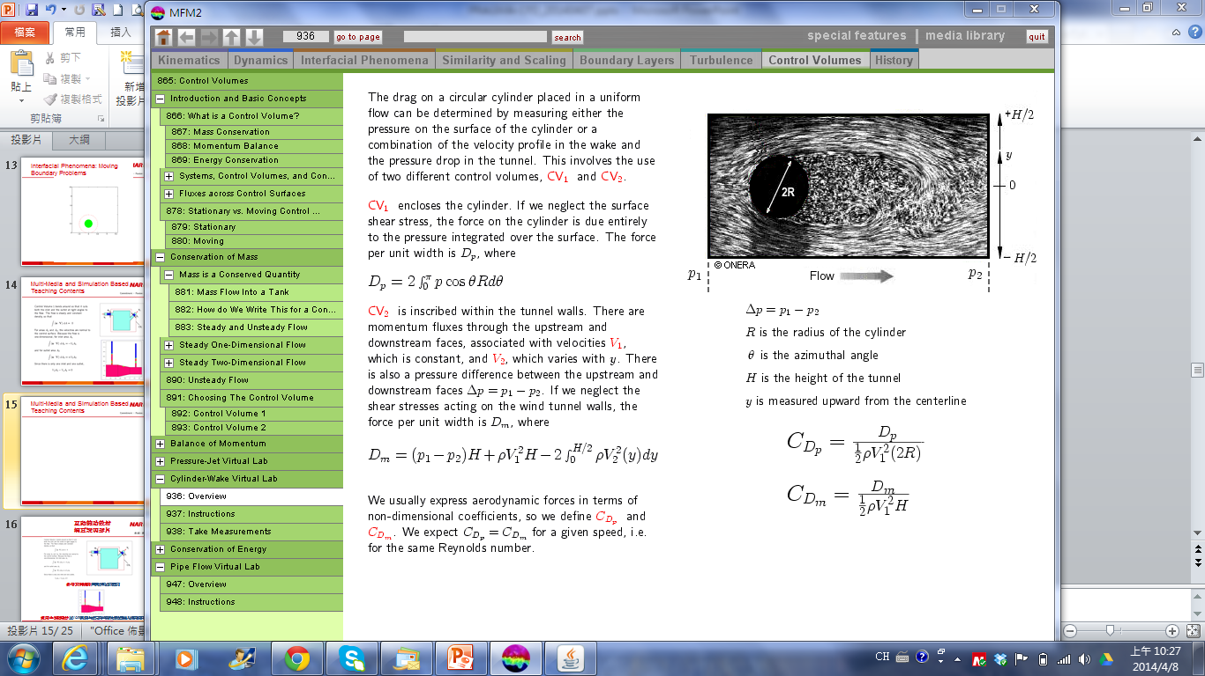
Multi-Media and Simulation Based Teaching Contents (1/2)

Slide 16
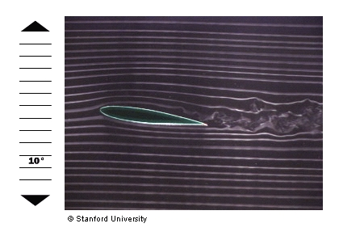
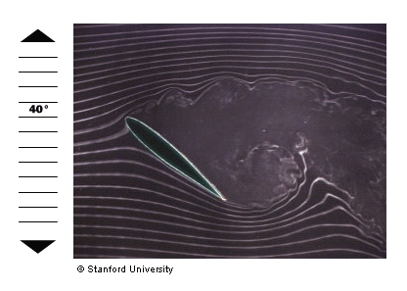
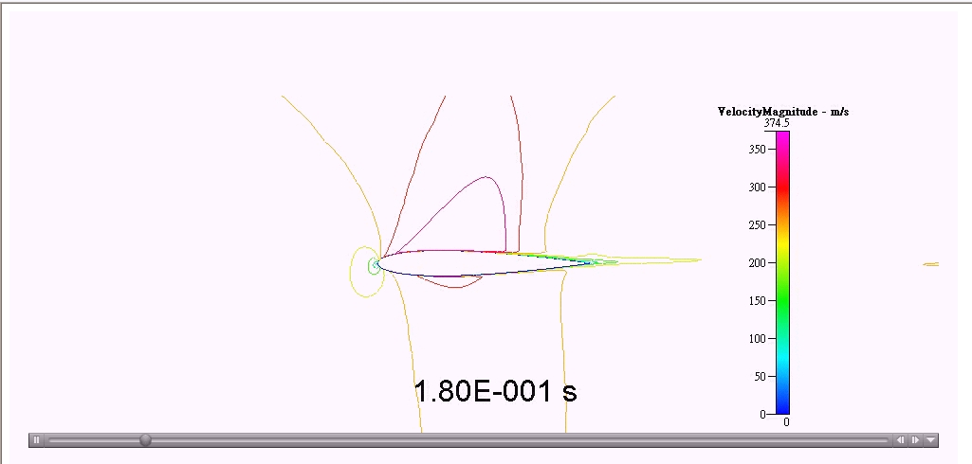
Multi-Media and Simulation Based Teaching Contents (2/2)

Slide 17
Future Works
Continue to Develop Interactive Simulation Cases as Supplemental Teaching Contents
Integrate Learning Path Management System with Modularization of Teaching Contents
Development of Applied Software Tools
Promotion for Thermal-Fluid Engineering Education Platform

Slide 18


